Slide 1

Spanish Legal Terms Through Time: Digitization
Marija Žarković European Master in Lexicography

Slide 2

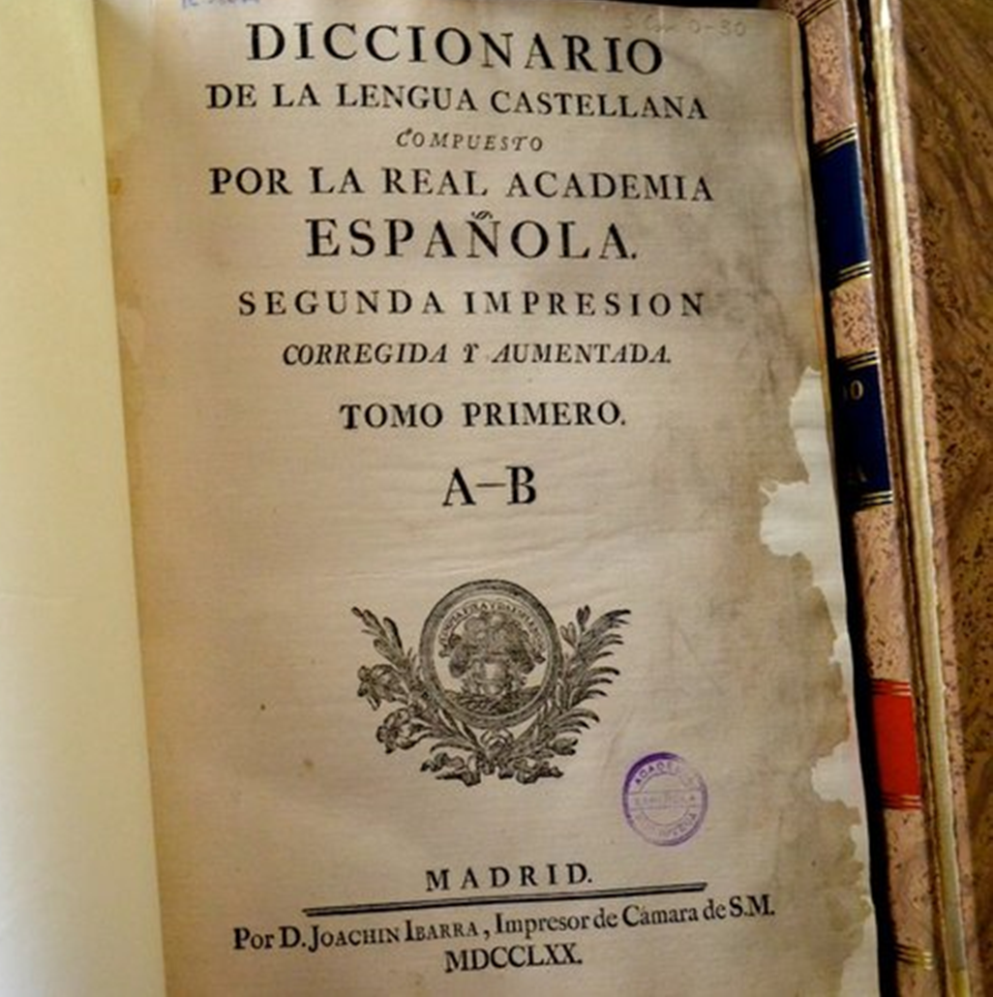
The Dictionary of Authorities
1726 - 1739

Slide 3
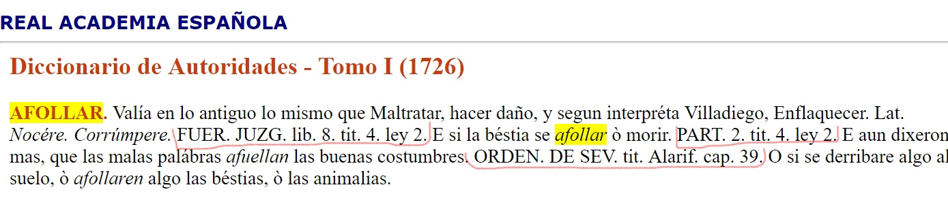

Slide 4
Editions of the Diccionario de la lengua española
Edition Year
1 1780
2 1783
3 1791
4 1803
5 1817
6 1822
7 1832
8 1837
9 1843
10 1852
11 1869
12 1884
Edition Year
13 1899
14 1914
15 1925
16 1936/1939
17 1947
18 1956
19 1970
20 1984
21 1992
22 2001
23 2014

Slide 5
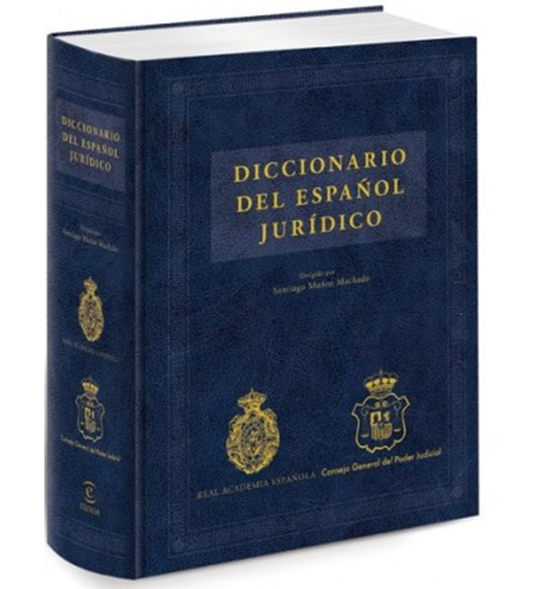
Spanish Juridical Dictionary
2016

Slide 6
Dictionary of Authorities (1726-1739)
Dictionary of Spanish Language (1817)
Dictionary of Spanish Language (1936-1939)
Spanish Juridical Dictionary (2016)
THE CORPUS

Slide 7
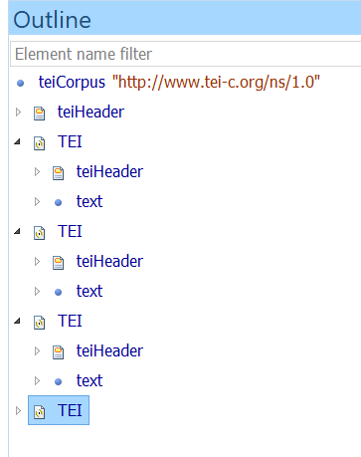
Compiling a teiCorpus

Slide 8
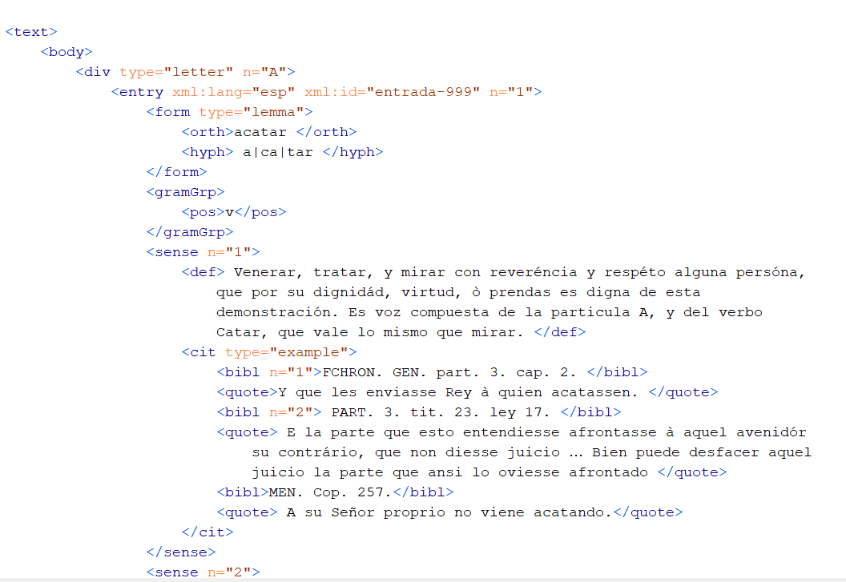
THE TEI STRUCTURE

Slide 9
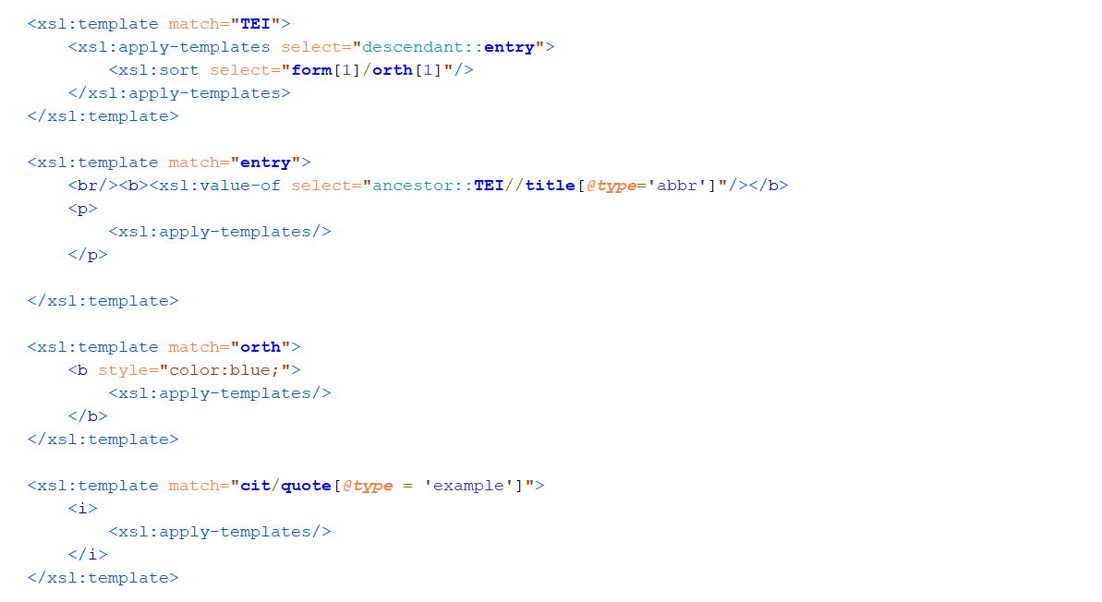
THE XSLT

Slide 10
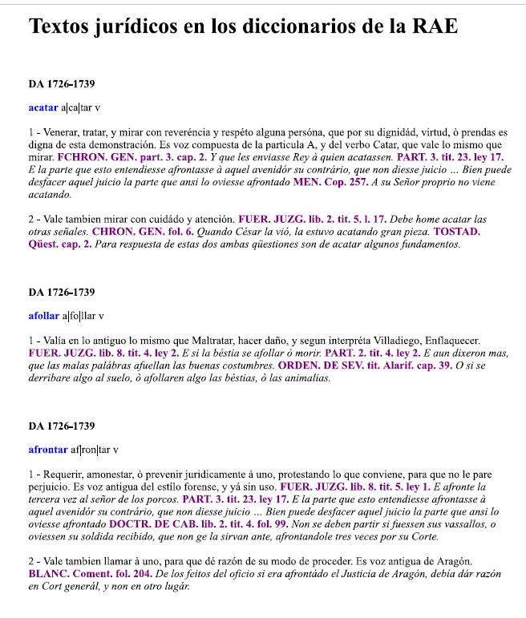
HTML file

Slide 11
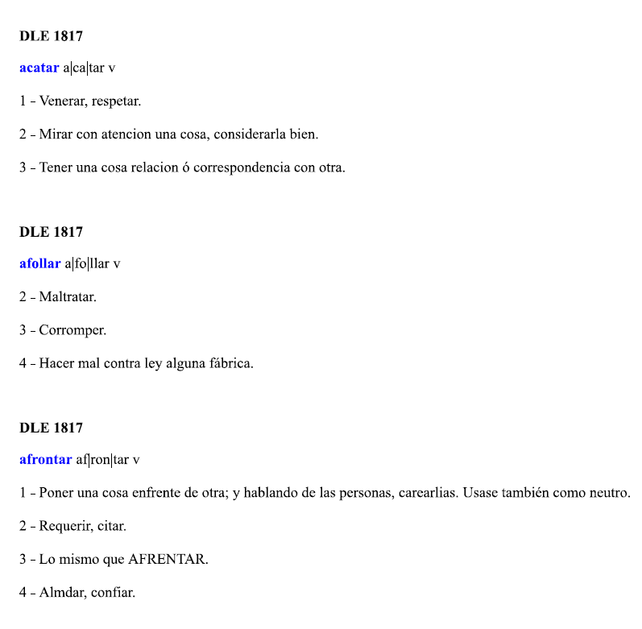
HTML file

Slide 12
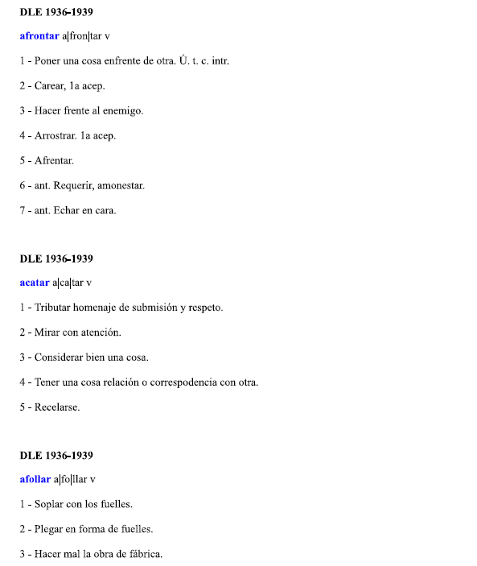
HTML file

Slide 13
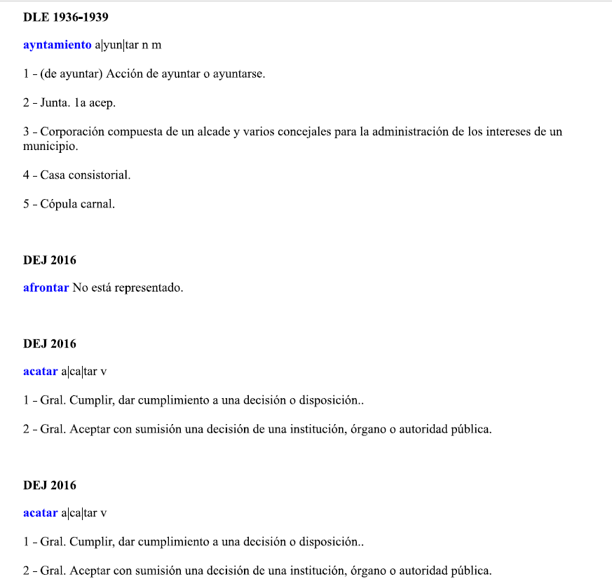
HTML file

